Slide 1
Endoscopic entero-enteric anastomosis using magnets: a mini-invasive approach to restore intestinal transit after bariatric surgery revision.
LOREDANA GUALTIERI, MD
DIGESTIVE ENDOSCOPY UNIT
POLICLINICO UNIVERSITARIO FONDAZIONE «AGOSTINO GEMELLI», ROME (RM)

Slide 2
CASE REPORT PRESENTATION
37-year-old man:
previous biliopancreatic diversion surgery in 2005 for obesity
admission to our hospital in April 2023 for recurrent cholangitis due to bile stones and severe physical malabsorption syndrome:
  exploratory laparotomy revealed a sub stenosis of the anastomotic complex, which was excised with the repackaging of the ileo-ileal anastomosis.
  because of the dehiscence of the anastomosis three days post-surgery, the patient underwent urgent exploratory laparotomy with further repackaging of the ileo-ileal anastomosis.
  patient developed persistent and debilitating occlusive intestinal symptoms and a CT-scan showed severe abdominal adhesions with a long stenosis of the anastomotic complex.

Slide 3
The patient was referred for a minimally invasive endoscopic approach to restore intestinal transit.
The entero-enteric anastomosis was reached by upper GI endoscopy, and a colonoscopy was performed till the pre-anastomotic terminal ileum, simultaneously.
Fluoroscopy confirmed the long stenosis of the upstream intestinal loops.
Endoscopic placement of magnets was performed to create an entero-entero-anastomosis.
Postoperatively, an abdomen CT scan with contrast showed the correct location of the magnets. Ten days after the procedure, the patient underwent placement of a lumen apposing metal stent (SPAXUS™ Stent) 20 x 16 mm under between the ileum and jejunum and removal of the endoscopic magnets.

Slide 4
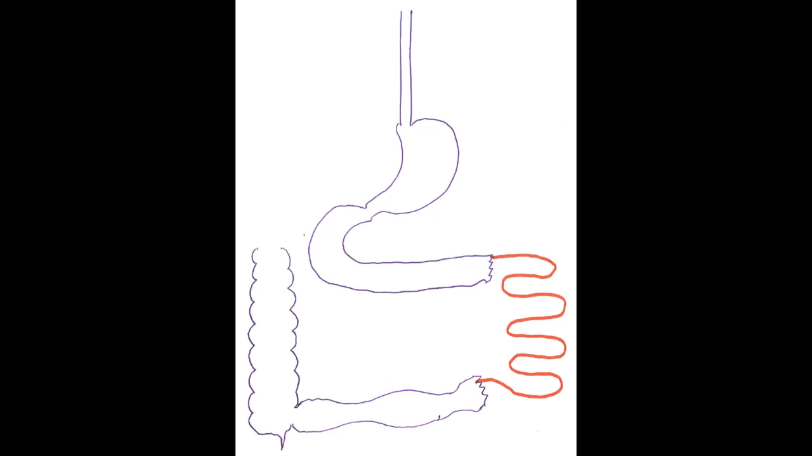
A CT-scan showed severe abdominal adhesions with a long stenosis of the anastomotic complex.

Slide 5
On the second post-procedural day, an abdomen TC scan with contrast confirmed the endoprosthesis correct placement. Progressive resumption of intestinal canalization and gradual restart of oral feeding were witnessed over the following days after the procedure. The patient’s clinical conditions gradually improved, and he was discharged 20 days following the procedure.
After 2 months, patient underwent an endoscopic examination with prosthesis removal and fluoroscopy showed proper of the anastomosis.

Slide 6
Thank you

